Slide 1
Introduction to Data Science
John P Dickerson
Lecture #2 – 08/29/2019
CMSC320
Tuesdays & Thursdays
5:00pm – 6:15pm

Slide 2
Announcements
Register on Piazza: piazza.com/umd/fall2019/cmsc320
210 have registered already
88 have not registered yet
If you were on Piazza, you’d know …
Project 0 is out! It is “due” next Wednesday evening.
Link: https://github.com/cmsc320/fall2019/tree/master/project0
We’ve also linked some reading for the week!
First quiz will be due Thursday at noon.
(Quiz should be up on ELMS now.)

Slide 3
The Data Lifecycle
Data collection
Data processing
Exploratory analysis
&
Data viz
Analysis, hypothesis testing, & ML
Insight & Policy Decision

Slide 4
Today’s Lecture
Data collection
Data processing
Exploratory analysis
&
Data viz
Analysis, hypothesis testing, & ML
Insight & Policy Decision

Slide 5
But first, snakes!
Python is an interpreted, dynamically-typed, high-level, garbage-collected, object-oriented-functional-imperative, and widely used scripting language.
Interpreted: instructions executed without being compiled into (virtual) machine instructions*
Dynamically-typed: verifies type safety at runtime
High-level: abstracted away from the raw metal and kernel
Garbage-collected: memory management is automated
OOFI: you can do bits of OO, F, and I programming
Not the point of this class!
Python is fast (developer time), intuitive, and used in industry!
*you can compile Python source, but it’s not required

Slide 6
The Zen of Python
Beautiful is better than ugly.
Explicit is better than implicit.
Simple is better than complex.
Complex is better than complicated.
Flat is better than nested.
Sparse is better than dense.
Readability counts.
Special cases aren't special enough to break the rules …
… although practicality beats purity.
Errors should never pass silently …
… unless explicitly silenced.
Thanks: SDSMT ACM/LUG

Slide 7
Literate Programming
Literate code contains in one document:
the source code;
text explanation of the code; and
the end result of running the code.
Basic idea: present code in the order that logic and flow of human thoughts demand, not the machine-needed ordering
Necessary for data science!
Many choices made need textual explanation, ditto results.
Stuff you’ll be using in Project 0 (and beyond)!

Slide 8
Jupyter Project
Started as iPython Notebooks, a web-based frontend to the iPython Shell
Notebook functionality separated out a few years ago
Now supports over 40 languages/kernels
Notebooks can be shared easily
Can leverage big data tools like Spark
Apache Zeppelin:
https://www.linkedin.com/pulse/comprehensive-comparison-jupyter-vs-zeppelin-hoc-q-phan-mba-
Several others including RStudio (specific to R)

Slide 9
10-minute Python primer
Define a function:
Python is whitespace-delimited
Define a function that returns a tuple:
def my_func(x, y):
if x > y:
return x
else:
return y
def my_func(x, y):
return (x-1, y+2)
(a, b) = my_func(1, 2)
a = 0; b = 4

Slide 10
Useful Built-in Functions: Counting and Iterating
len: returns the number of items of an enumerable object
range: returns an iterable object
enumerate: returns iterable tuple (index, element) of a list
https://docs.python.org/3/library/functions.html
len( [‘c’, ‘m’, ‘s’, ‘c’, 3, 2, 0] )
7
list( range(10) )
[0, 1, 2, 3, 4, 5, 6, 7, 8, 9]
enumerate( [“311”, “320”, “330”] )
[(0, “311”), (1, “320”), (2, “330”)]
Notes:
do demo

Slide 11
Useful Built-In Functions: Map and Filter
map: apply a function to a sequence or iterable
filter: returns a list* of elements for which a predicate is true
We’ll go over in much greater depth with pandas/numpy.
arr = [1, 2, 3, 4, 5]
map(lambda x: x**2, arr)
[1, 4, 9, 16, 25]
arr = [1, 2, 3, 4, 5, 6, 7]
filter(lambda x: x % 2 == 0, arr)
[2, 4, 6]
*in Python 3, returns Iterable

Slide 12
Pythonic Programming
Basic iteration over an array in Java:
Direct translation into Python:
A more “Pythonic” way of iterating:
int[] arr = new int[10];
for(int idx=0; idx<arr.length; ++idx) {
System.out.println( arr[idx] );
}
idx = 0
while idx < len(arr):
print( arr[idx] ); idx += 1
for element in arr:
print( element )

Slide 13
List comprehensions
Construct sets like a mathematician!
P = { 1, 2, 4, 8, 16, …, 2¹⁶ }
E = { x | x in ℕ and x is odd and x < 1000 }
Construct lists like a mathematician who codes!
Very similar to map, but:
You’ll see these way more than map in the wild
Many people consider map/filter not “pythonic”
They can perform differently (map is “lazier”)
P = [ 2**x for x in range(17) ]
E = [ x for x in range(1000) if x % 2 != 0 ]

Slide 14
Exceptions
Syntactically correct statement throws an exception:
tweepy (Python Twitter API) returns “Rate limit exceeded”
sqlite (a file-based database) returns IntegrityError
print('Python', python_version())
try:
cause_a_NameError
except NameError as err:
print(err, '-> some extra text')

Slide 15
Python 2 vs 3
Python 3 is intentionally backwards incompatible
(But not that incompatible)
Biggest changes that matter for us:
print “statement” → print(“function”)
1/2 = 0 → 1/2 = 0.5 and 1//2 = 0
ASCII str default → default Unicode
Namespace ambiguity fixed:
i = 1
[i for i in range(5)]
print(i) # ????????
Notes:
Prints “4” in Python 2 and “1” (i.e., unchanged because the list comprehension scope is dead) in Python 3.

Slide 16
To any Curmudgeons …
If you’re going to use Python 2 anyway, use the _future_ module:
Python 3 introduces features that will throw runtime errors in Python 2 (e.g., with statements)
_future_ module incrementally brings 3 functionality into 2
https://docs.python.org/2/library/__future__.html
from _future_ import division
from _future_ import print_function
from _future_ import please_just_use_python_3

Slide 17
So, How does Import Work?
Python code is stored in module – simply put, a file full of Python code
A package is a directory (tree) full of modules that also contains a file called __init.py__
Packages let you structure Python’s module namespace
E.g., X.Y is a submodule Y in a package named X
For one module to gain access to code in another module, it must import it

Slide 18
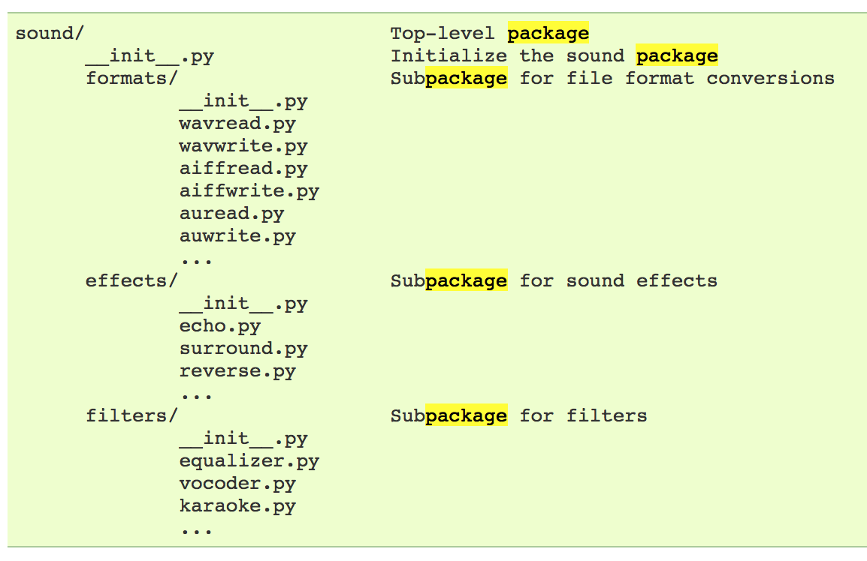
Example
# Load (sub)module sound.effects.echo
import sound.effects.echo
# Must use full name to reference echo functions
sound.effects.echo.echofilter(input, output, delay=0.7)
https://docs.python.org/2/tutorial/modules.html

Slide 19
Example
# Load (sub)module sound.effects.echo
import sound.effects.echo
# Must use full name to reference echo functions
sound.effects.echo.echofilter(input, output, delay=0.7)
# Load (sub)module sound.effects.echo
from sound.effects import echo
# No longer need the package prefix for functions in echo
echo.echofilter(input, output, delay=0.7)
# Load a specific function directly
from sound.effects.echo import echofilter
# Can now use that function with no prefix
echofilter(input, output, delay=0.7)
https://docs.python.org/2/tutorial/modules.html

Slide 20
Python vS R (For Data Scientists)
There is no right answer here!
Python is a “full” programming language – easier to integrate with systems in the field
R has a more mature set of pure stats libraries …
… but Python is catching up quickly …
… and is already ahead specifically for ML.
You will see Python more in the tech industry.

Slide 21
Extra resources
Plenty of tutorials on the web:
https://www.learnpython.org/
Work through Project 0, which will take you through some baby steps with Python and the Pandas library:
(We’ll also post some more readings soon.)
Come hang out at office hours (or chat with me privately)
All office hours will be on the website/Piazza by tomorrow.
Will have coverage MTWThF.

Slide 23
Today’s Lecture
Data collection
Data processing
Exploratory analysis
&
Data viz
Analysis, hypothesis testing, & ML
Insight & Policy Decision
with
Thanks: Zico Kolter’s 15-388, Amol Deshpande, Nick Mattei

Slide 24

What is This “data”?

Slide 25
Tabular Data
Quick teaser. We’ll go into greater depth when discussing tidy data.
Data is an abstraction of some real world entity.
Also called: instance, example, record, object, case, individual.
Each of these entities is described by a set of features.
Sometimes called variables, features, attributes, …
Can be processed into an n (number of entities) by m (number of attributes) matrix.
Result of merging & processing different records!
Picking the data that goes into this table has both technical and ethical concerns (recall: Target, Netflix, AOL examples)
ID | Title | Author | Year | Cover | Edition | Price
1 | Emma | Austen | 1815 | Paper | 20th | $5.75
2 | Dracula | Stoker | 1897 | Hard | 15th | $12.00
3 | Ivanhoe | Scott | 1820 | Hard | 8th | $25.00
4 | Kidnapped | Stevenson | 1886 | Paper | 11th | $5.00

Slide 26
Classical Statistical View of Data
There are four classical types of data
Data Types
Categorical
Numerical
Interval
Ratio
Nominal
Ordinal

Slide 27


Categorical Data: Takes a Value From a Finite Set
Nominal (aka Categorical) Data:
Values have names: describe the categories, classes, or states of things
Marital status, drink type, or some binary attribute
Cannot compare easily, thus cannot naturally order them
Ordinal Data:
Values have names: describe the categories, classes, or states of things
However, there is an ordering over the values:
Strongly like, like, neutral, strongly dislike
Lacks a mathematical notion of distance between the values
This distinction can be blurry…
Is there an ordering over: sunny, overcast, rainy?

Slide 28
Numerical Data: Measured Using Integers or Reals
Interval Scale:
Scale with fixed but arbitrary interval (e.g., dates)
The difference between two values is meaningful:
Difference between 9/1/2019 and 10/1/2019 is the same as the difference between 9/1/2018 and 10/1/2018
Can’t compute ratios or scales: e.g., what unit is 9/1/2019 * 8/2/2020?
Ratio Scale:
All the same properties as interval scale data, but the scale of measurement also possesses a true-zero origin
Can look at the ratio of two quantities (unlike interval)
E.g., zero money is an absolute, one money is half as much as two money, and so on

Slide 29

Numerical Data: Examples
Temperatures:
Celsius / Fahrenheit: interval or ratio scale ???????????
Interval: 0C is not 0 heat, but is an arbitrary fixed point
Hence, we can’t say that 30F is twice as warm as 15F.
Kelvin (K): interval or ratio scale ???????????
Ratio: 0K is assumed to mean zero heat, a true fixed point
Weight:
Grams: interval or ratio scale ??????????
Ratio: 0g served as fixed point, 4g is twice 2g, …

Slide 30
General Rules
OK to compute.... | Nominal | Ordinal | Interval | Ratio
frequency distribution | Yes | Yes | Yes | Yes
median and percentiles | No | Yes | Yes | Yes
add or subtract | No | No | Yes | Yes
mean, standard deviation, standard error of the mean | No | No | Yes | Yes
ratio, or coefficient of variation | No | No | No | Yes
?
?
?
?
Thanks to GraphPad

Slide 31
General Rules
OK to compute.... | Nominal | Ordinal | Interval | Ratio
frequency distribution | Yes | Yes | Yes | Yes
median and percentiles | No | Yes | Yes | Yes
add or subtract | No | No | Yes | Yes
mean, standard deviation, standard error of the mean | No | No | Yes | Yes
ratio, or coefficient of variation | No | No | No | Yes
?
?
?
?

Slide 32
General Rules
OK to compute.... | Nominal | Ordinal | Interval | Ratio
frequency distribution | Yes | Yes | Yes | Yes
median and percentiles | No | Yes | Yes | Yes
addition or subtraction | No | No | Yes | Yes
mean, standard deviation, standard error of the mean | No | No | Yes | Yes
ratio, or coefficient of variation | No | No | No | Yes
?
?
?
?

Slide 33
General Rules
OK to compute.... | Nominal | Ordinal | Interval | Ratio
frequency distribution | Yes | Yes | Yes | Yes
median and percentiles | No | Yes | Yes | Yes
addition or subtraction | No | No | Yes | Yes
mean or standard deviation | No | No | Yes | Yes
ratio, or coefficient of variation | No | No | No | Yes
?
?
?
?

Slide 34
General Rules
OK to compute.... | Nominal | Ordinal | Interval | Ratio
frequency distribution | Yes | Yes | Yes | Yes
median and percentiles | No | Yes | Yes | Yes
addition or subtraction | No | No | Yes | Yes
mean or standard deviation | No | No | Yes | Yes
ratio, or coefficient of variation | No | No | No | Yes
?
?
?
?
Notes:
Coefficient of variation aka “relative standard deviation” – generally the ratio of the standard deviation to the mean of the sample – 0% = point (stdev 0 divided by mean), higher is more variable

Slide 35
General Rules
OK to compute.... | Nominal | Ordinal | Interval | Ratio
frequency distribution | Yes | Yes | Yes | Yes
median and percentiles | No | Yes | Yes | Yes
addition or subtraction | No | No | Yes | Yes
mean or standard deviation | No | No | Yes | Yes
ratio, or coefficient of variation | No | No | No | Yes
Notes:
Coefficient of variation aka “relative standard deviation” – generally the ratio of the standard deviation to the mean of the sample – 0% = point (stdev 0 divided by mean), higher is more variable

Slide 36
Data Manipulation and Computation
Data Science == manipulating and computing on data
Large to very large, but somewhat “structured” data
We will see several tools for doing that this semester
Thousands more out there that we won’t cover
Need to learn to shift thinking from:
Imperative code to manipulate data structures
to:
Sequences/pipelines of operations on data
Should still know how to implement the operations themselves, especially for debugging performance (covered in classes like 420, 424), but we won’t cover that much

Slide 37
Data Manipulation and Computation
Data Representation, i.e., what is the natural way to think about given data
Data Processing Operations, which take one or more datasets as input and produce one or more datasets as output
Indexing
Slicing/subsetting
Filter
‘map’ → apply a function to every element
’reduce/aggregate’ → combine values to get a single scalar (e.g., sum, median)
Given two vectors: Dot and cross products
One-dimensional Arrays, Vectors
0.1 | 2 | 3.2 | 6.5 | 3.4 | 4.1
“data” | ”representation” | ”i.e.”

Slide 38
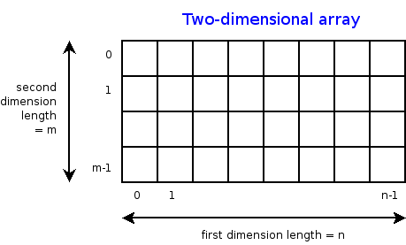
Data Manipulation and Computation
Data Representation, i.e., what is the natural way to think about given data
Data Processing Operations, which take one or more datasets as input and produce one or more datasets as output
Indexing
Slicing/subsetting
Filter
‘map’ → apply a function to every element
’reduce/aggregate’ → combine values across a row or a column (e.g., sum, average, median etc..)
n-dimensional arrays

Slide 39
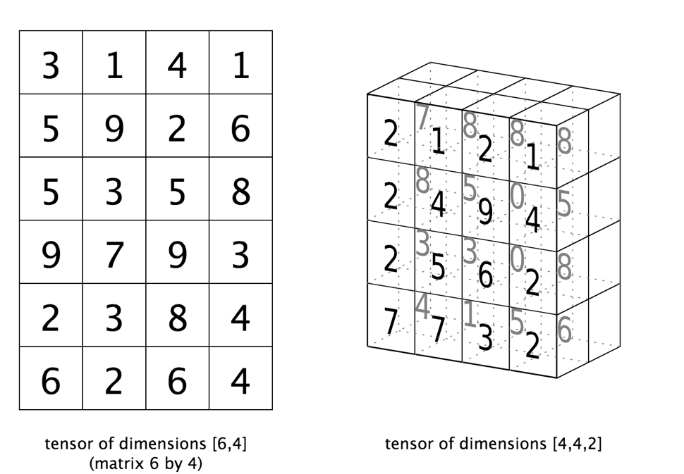
Data Manipulation and Computation
Data Representation, i.e., what is the natural way to think about given data
Data Processing Operations, which take one or more datasets as input and produce one or more datasets as output
Matrices, Tensors
n-dimensional array operations
+
Linear Algebra
Matrix/tensor multiplication
Transpose
Matrix-vector multiplication
Matrix factorization

Slide 40
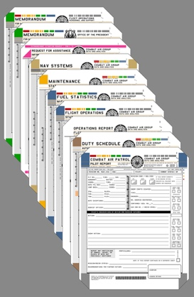

Data Manipulation and Computation
Data Representation, i.e., what is the natural way to think about given data
Data Processing Operations, which take one or more datasets as input and produce one or more datasets as output
Sets: of Objects
Filter
Map
Union
Reduce/Aggregate
Given two sets, Combine/Join using “keys”
Group and then aggregate
Sets: of (Key, Value Pairs)
(amol@cs.umd.edu,(email1, email2,…))
(john@cs.umd.edu,(email3, email4,…))

Slide 41
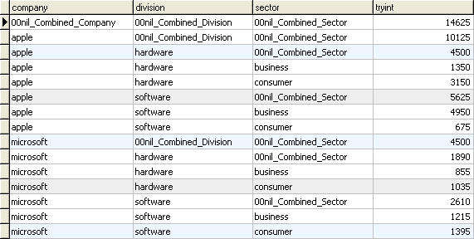
Data Manipulation and Computation
Data Representation, i.e., what is the natural way to think about given data
Data Processing Operations, which take one or more datasets as input and produce one or more datasets as output
Filter rows or columns
”Join” two or more relations
”Group” and “aggregate” them
Relational Algebra formalizes some of them
Structured Query Language (SQL)
Many other languages and constructs, that look very similar
Tables/Relations == Sets of Tuples

Slide 42
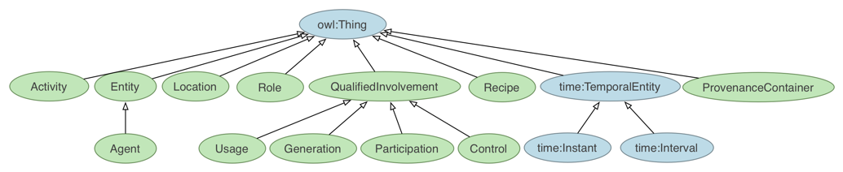
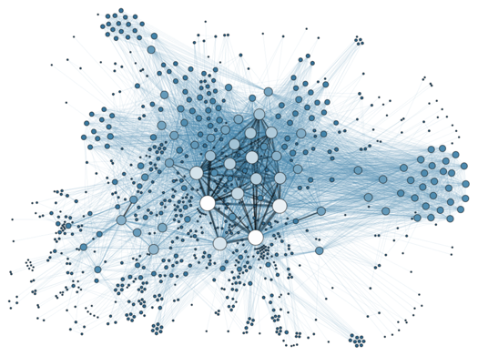
Data Manipulation and Computation
Data Representation, i.e., what is the natural way to think about given data
Data Processing Operations, which take one or more datasets as input and produce one or more datasets as output
Hierarchies/Trees/Graphs
”Path” queries
Graph Algorithms and Transformations
Network Science
Somewhat more ad hoc and special-purpose
Changing in recent years

Slide 43
Data Manipulation and Computation
Data Representation, i.e., what is the natural way to think about given data
Data Processing Operations, which take one or more datasets as input and produce
Why?
Allows one to think at a higher level of abstraction, leading to simpler and easier-to-understand scripts
Provides ”independence” between the abstract operations and concrete implementation
Can switch from one implementation to another easily
For performance debugging, useful to know how they are implemented and rough characteristics

Slide 44
Today’s Lecture
Data collection
Data processing
Exploratory analysis
&
Data viz
Analysis, hypothesis testing, & ML
Insight & Policy Decision
… on to the “collection” part of things …

Slide 45
GotTa Catch ‘Em All
Five ways to get data:
Direct download and load from local storage
Generate locally via downloaded code (e.g., simulation)
Query data from a database (covered in a few lectures)
Query an API from the intra/internet
Scrape data from a webpage
Covered today.

Slide 46
Wherefore art thou, API?
A web-based Application Programming Interface (API) like we’ll be using in this class is a contract between a server and a user stating:
“If you send me a specific request, I will return some information in a structured and documented format.”
(More generally, APIs can also perform actions, may not be web-based, be a set of protocols for communicating between processes, between an application and an OS, etc.)
Notes:
”Wherefore” means “why”, not “where”!

Slide 47
“Send me a specific request”
Most web API queries we’ll be doing will use HTTP requests:
conda install –c anaconda requests=2.12.4
r = requests.get( 'https://api.github.com/user', auth=('user', 'pass') )
r.status_code
200
r.headers[‘content-type’]
‘application/json; charset=utf8’
r.json()
{u'private_gists': 419, u'total_private_repos': 77, ...}
http://docs.python-requests.org/en/master/

Slide 48
HTTP Requests
https://www.google.com/?q=cmsc320&tbs=qdr:m
HTTP GET Request:
GET /?q=cmsc320&tbs=qdr:m HTTP/1.1 Host: www.google.com User-Agent: Mozilla/5.0 (X11; Linux x86_64; rv:10.0.1) Gecko/20100101 Firefox/10.0.1
??????????
params = { “q”: “cmsc320”, “tbs”: “qdr:m” }
r = requests.get( “https://www.google.com”, params = params )
*be careful with https:// calls; requests will not verify SSL by default

Slide 49
Restful APIs
This class will just query web APIs, but full web APIs typically allow more.
Representational State Transfer (RESTful) APIs:
GET: perform query, return data
POST: create a new entry or object
PUT: update an existing entry or object
DELETE: delete an existing entry or object
Can be more intricate, but verbs (“put”) align with actions

Slide 50
Querying a Restful API
Stateless: with every request, you send along a token/authentication of who you are
GitHub is more than a GETHub:
PUT/POST/DELETE can edit your repositories, etc.
Try it out: https://github.com/settings/tokens/new
token = ”super_secret_token”
r = requests.get(“https://github.com/user”,
params={”access_token”: token})
print( r.content )
{"login":”JohnDickerson","id":472985,"avatar_url":"ht…

Slide 51
Authentication and OAuth
Old and busted:
New hotness:
What if I wanted to grant an app access to, e.g., my Facebook account without giving that app my password?
OAuth: grants access tokens that give (possibly incomplete) access to a user or app without exposing a password
r = requests.get(“https://api.github.com/user”,
auth=(“JohnDickerson”, “ILoveKittens”))

Slide 52
“… I will return information in a structured format.”
So we’ve queried a server using a well-formed GET request via the requests Python module. What comes back?
General structured data:
Comma-Separated Value (CSV) files & strings
Javascript Object Notation (JSON) files & strings
HTML, XHTML, XML files & strings
Domain-specific structured data:
Shapefiles: geospatial vector data (OpenStreetMap)
RVT files: architectural planning (Autodesk Revit)
You can make up your own! Always document it.

Slide 53
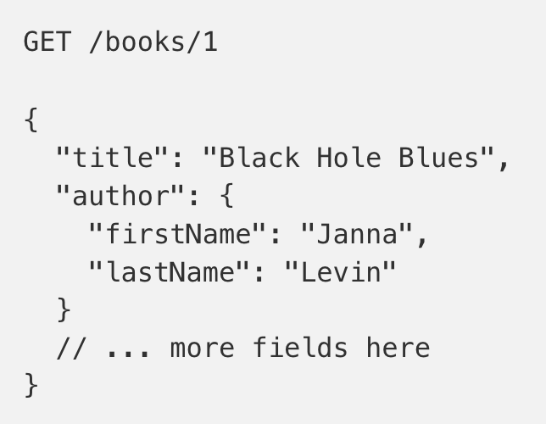
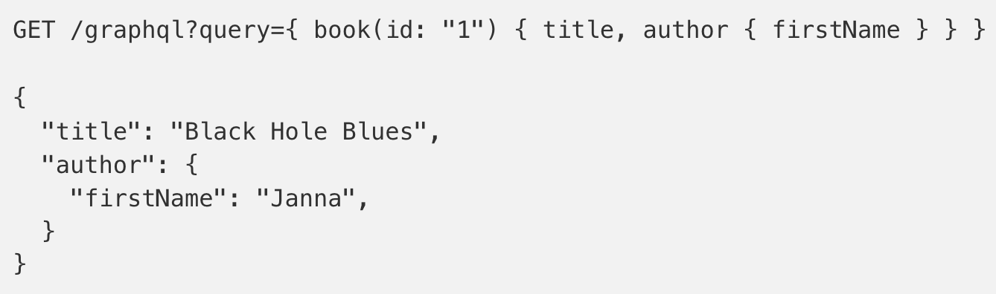
GraphQL?
An alternative to REST and ad-hoc webservice architectures
Developed internally by Facebook and released publicly
Unlike REST, the requester specifies the format of the response
https://dev-blog.apollodata.com/graphql-vs-rest-5d425123e34b

Slide 54
CSV Files in Python
Any CSV reader worth anything can parse files with any delimiter, not just a comma (e.g., “TSV” for tab-separated)
1,26-Jan,Introduction,—,"pdf, pptx",Dickerson, 2,31-Jan,Scraping Data with Python,Anaconda's Test Drive.,,Dickerson, 3,2-Feb,"Vectors, Matrices, and Dataframes",Introduction to pandas.,,Dickerson, 4,7-Feb,Jupyter notebook lab,,,"Denis, Anant, & Neil", 5,9-Feb,Best Practices for Data Science Projects,,,Dickerson,
Don’t write your own CSV or JSON parser
(We’ll use pandas to do this much more easily and efficiently)
import csv
with open(“schedule.csv”, ”rb”) as f:
reader = csv.reader(f, delimiter=“,”, quotechar=’”’)
for row in reader:
print(row)

Slide 55
JSON Files & Strings
JSON is a method for serializing objects:
Convert an object into a string (done in Java in 131/132?)
Deserialization converts a string back to an object
Easy for humans to read (and sanity check, edit)
Defined by three universal data structures
Python dictionary, Java Map, hash table, etc …
Python list, Java array, vector, etc …
Python string, float, int, boolean, JSON object, JSON array, …
Images from: http://www.json.org/

Slide 56
JSON In Python
Some built-in types: “Strings”, 1.0, True, False, None
Lists: [“Goodbye”, “Cruel”, “World”]
Dictionaries: {“hello”: “bonjour”, “goodbye”, “au revoir”}
Dictionaries within lists within dictionaries within lists:
[1, 2, {“Help”:[ “I’m”, {“trapped”: “in”}, “CMSC320” ]}]

Slide 57
JSON From Twitter
GET https://api.twitter.com/1.1/friends/list.json?cursor=-1&screen_name=twitterapi&skip_status=true&include_user_entities=false
{ "previous_cursor": 0,
"previous_cursor_str": "0",
"next_cursor": 1333504313713126852,
"users": [{
"profile_sidebar_fill_color": "252429",
"profile_sidebar_border_color": "181A1E",
"profile_background_tile": false,
"name": "Sylvain Carle",
"profile_image_url": "http://a0.twimg.com/profile_images/2838630046/4b82e286a659fae310012520f4f756bb_normal.png",
"created_at": "Thu Jan 18 00:10:45 +0000 2007", …

Slide 58
Parsing JSON In Python
Repeat: don’t write your own CSV or JSON parser
https://news.ycombinator.com/item?id=7796268
rsdy.github.io/posts/dont_write_your_json_parser_plz.html
Python comes with a fine JSON parser
import json
r = requests.get( “https://api.twitter.com/1.1/statuses/user_timeline.json?screen_name=JohnPDickerson&count=100”, auth=auth )
data = json.loads(r.content)
json.load(some_file) # loads JSON from a file
json.dump(json_obj, some_file) # writes JSON to file
json.dumps(json_obj) # returns JSON string

Slide 59
XML, XHTML, HTML files and Strings
Still hugely popular online, but JSON has essentially replaced XML for:
Asynchronous browser ←→ server calls
Many (most?) newer web APIs
XML is a hierarchical markup language:
<tag attribute=“value1”> <subtag> Some content goes here </subtag> <openclosetag attribute=“value2” /> </tag>
You probably won’t see much XML, but you will see plenty of HTML, its substantially less well-behaved cousin …
Example XML from: Zico Kolter

Slide 60
Document Object Model (DOM)
XML encodes Document-Object Models (“the DOM”)
The DOM is tree-structured.
Easy to work with! Everything is encoded via links.
Can be huge, & mostly full of stuff you don’t need …

Slide 61
SAX
SAX (Simple API for XML) is an alternative “lightweight” way to process XML.
A SAX parser generates a stream of events as it parses the XML file. The programmer registers handlers for each one.
It allows a programmer to handle only parts of the data structure.
Example from John Canny

Slide 62
Scraping HTML in Python
HTML – the specification – is fairly pure
HTML – what you find on the web – is horrifying
We’ll use BeautifulSoup:
conda install -c asmeurer beautiful-soup=4.3.2
import requests
from bs4 import BeautifulSoup
r = requests.get( “https://cs.umd.edu/class/fall2019/cmsc320/” )
root = BeautifulSoup( r.content )
root.find(“div”, id=“schedule”)\
.find(“table”)\ # find all schedule
.find(“tbody”).findAll(“a”) # links for CMSC320

Slide 63
Building a web scraper in python
Totally not hypothetical situation:
You really want to learn about data science, so you choose to download all of last semester’s CMSC320 lecture slides to wallpaper your room …
… but you now have carpal tunnel syndrome from clicking refresh on Piazza last night, and can no longer click on the PDF and PPTX links.
Hopeless? No! Earlier, you built a scraper to do this!
Sort of. You only want PDF and PPTX files, not links to other websites or files.
lnks = root.find(“div”, id=“schedule”)\
.find(“table”)\ # find all schedule
.find(“tbody”).findAll(“a”) # links for CMSC320

Slide 64
Regular Expressions
Given a list of URLs (strings), how do I find only those strings that end in *.pdf or *.pptx?
Regular expressions!
(Actually Python strings come with a built-in endswith function.)
What about .pDf or .pPTx, still legal extensions for PDF/PPTX?
Regular expressions!
(Or cheat the system again: built-in string lower function.)
“this_is_a_filename.pdf”.endswith((“.pdf”, “.pptx”))
“tHiS_IS_a_FileNAme.pDF”.lower().endswith( (“.pdf”, “.pptx”))

Slide 65
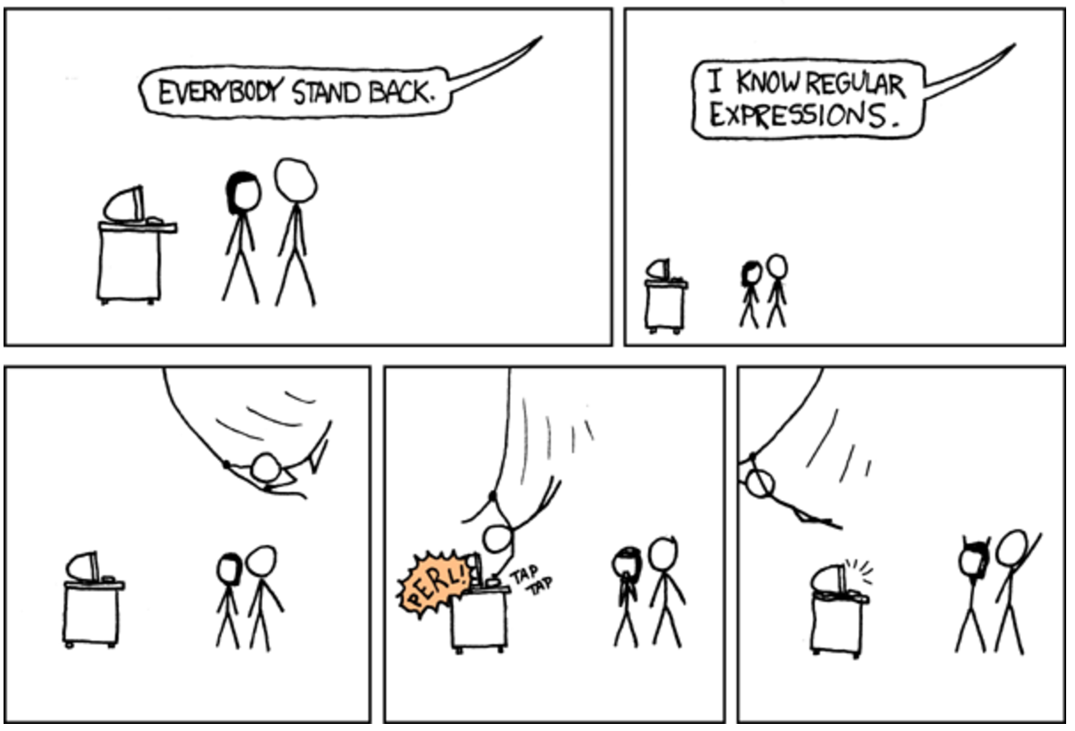

Slide 66
Regular Expressions
Used to search for specific elements, or groups of elements, that match a pattern
Indispensable for data munging and wrangling
Many constructs to search a variety of different patterns
Many languages/libraries (including Python) allow “compiling”
Much faster for repeated applications of the regex pattern
https://blog.codinghorror.com/to-compile-or-not-to-compile/

Slide 67
Regular Expressions
Used to search for specific elements, or groups of elements, that match a pattern
import re
# Find the index of the 1st occurrence of “cmsc320”
match = re.search(r”cmsc320”, text)
print( match.start() )
# Does start of text match “cmsc320”?
match = re.match(r”cmsc320”, text)
# Iterate over all matches for “cmsc320” in text
for match in re.finditer(r”cmsc320”, text):
print( match.start() )
# Return all matches of “cmsc320” in the text
match = re.findall(r”cmsc320”, text)

Slide 68
Matching Multiple Characters
Can match sets of characters, or multiple and more elaborate sets and sequences of characters:
Match the character ‘a’: a
Match the character ‘a’, ‘b’, or ‘c’: [abc]
Match any character except ‘a’, ‘b’, or ‘c’: [^abc]
Match any digit: \d (= [0123456789] or [0-9])
Match any alphanumeric: \w (= [a-zA-Z0-9_])
Match any whitespace: \s (= [ \t\n\r\f\v])
Match any character: .
Special characters must be escaped: .^$*+?{}\[]|()
Thanks to: Zico Kolter

Slide 69
Matching sequences and repeated characters
A few common modifiers (available in Python and most other high-level languages; +, {n}, {n,} may not):
Match character ‘a’ exactly once: a
Match character ‘a’ zero or once: a?
Match character ‘a’ zero or more times: a*
Match character ‘a’ one or more times: a+
Match character ‘a’ exactly n times: a{n}
Match character ‘a’ at least n times: a{n,}
Example: match all instances of “University of <somewhere>” where <somewhere> is an alphanumeric string with at least 3 characters:
\s*University\sof\s\w{3,}

Slide 70
Groups
What if we want to know more than just “did we find a match” or “where is the first match” …?
Grouping asks the regex matcher to keep track of certain portions – surrounded by (parentheses) – of the match
\s*([Uu]niversity)\s([Oo]f)\s(\w{3,})
regex = r”\s*([Uu]niversity)\s([Oo]f)\s(\w{3,})”
m = re.search( regex, “university Of Maryland” )
print( m.groups() )
('university', 'Of', 'Maryland')

Slide 71
Simple Example: Parse an Email Address
(?:(?:\r\n)?[ \t])*(?:(?:(?:[^()<>@,;:\\".\[\] \000-\031]+(?:(?:(?:\r\n)?[ \t] )+|\Z|(?=[\["()<>@,;:\\".\[\]]))|"(?:[^\"\r\\]|\\.|(?:(?:\r\n)?[ \t]))*"(?:(?: \r\n)?[ \t])*)(?:\.(?:(?:\r\n)?[ \t])*(?:[^()<>@,;:\\".\[\] \000-\031]+(?:(?:( ?:\r\n)?[ \t])+|\Z|(?=[\["()<>@,;:\\".\[\]]))|"(?:[^\"\r\\]|\\.|(?:(?:\r\n)?[ \t]))*"(?:(?:\r\n)?[ \t])*))*@(?:(?:\r\n)?[ \t])*(?:[^()<>@,;:\\".\[\] \000-\0 31]+(?:(?:(?:\r\n)?[ \t])+|\Z|(?=[\["()<>@,;:\\".\[\]]))|\[([^\[\]\r\\]|\\.)*\ ](?:(?:\r\n)?[ \t])*)(?:\.(?:(?:\r\n)?[ \t])*(?:[^()<>@,;:\\".\[\] \000-\031]+ (?:(?:(?:\r\n)?[ \t])+|\Z|(?=[\["()<>@,;:\\".\[\]]))|\[([^\[\]\r\\]|\\.)*\](?: (?:\r\n)?[ \t])*))*|(?:[^()<>@,;:\\".\[\] \000-\031]+(?:(?:(?:\r\n)?[ \t])+|\Z |(?=[\["()<>@,;:\\".\[\]]))|"(?:[^\"\r\\]|\\.|(?:(?:\r\n)?[ \t]))*"(?:(?:\r\n) ?[ \t])*)*\<(?:(?:\r\n)?[ \t])*(?:@(?:[^()<>@,;:\\".\[\] \000-\031]+(?:(?:(?:\ r\n)?[ \t])+|\Z|(?=[\["()<>@,;:\\".\[\]]))|\[([^\[\]\r\\]|\\.)*\](?:(?:\r\n)?[ \t])*)(?:\.(?:(?:\r\n)?[ \t])*(?:[^()<>@,;:\\".\[\] \000-\031]+(?:(?:(?:\r\n) ?[ \t])+|\Z|(?=[\["()<>@,;:\\".\[\]]))|\[([^\[\]\r\\]|\\.)*\](?:(?:\r\n)?[ \t] )*))*(?:,@(?:(?:\r\n)?[ \t])*(?:[^()<>@,;:\\".\[\] \000-\031]+(?:(?:(?:\r\n)?[ \t])+|\Z|(?=[\["()<>@,;:\\".\[\]]))|\[([^\[\]\r\\]|\\.)*\](?:(?:\r\n)?[ \t])* )(?:\.(?:(?:\r\n)?[ \t])*(?:[^()<>@,;:\\".\[\] \000-\031]+(?:(?:(?:\r\n)?[ \t] )+|\Z|(?=[\["()<>@,;:\\".\[\]]))|\[([^\[\]\r\\]|\\.)*\](?:(?:\r\n)?[ \t])*))*) *:(?:(?:\r\n)?[ \t])*)?(?:[^()<>@,;:\\".\[\] \000-\031]+(?:(?:(?:\r\n)?[ \t])+ |\Z|(?=[\["()<>@,;:\\".\[\]]))|"(?:[^\"\r\\]|\\.|(?:(?:\r\n)?[ \t]))*"(?:(?:\r \n)?[ \t])*)(?:\.(?:(?:\r\n)?[ \t])*(?:[^()<>@,;:\\".\[\] \000-\031]+(?:(?:(?: \r\n)?[ \t])+|\Z|(?=[\["()<>@,;:\\".\[\]]))|"(?:[^\"\r\\]|\\.|(?:(?:\r\n)?[ \t ]))*"(?:(?:\r\n)?[ \t])*))*@(?:(?:\r\n)?[ \t])*(?:[^()<>@,;:\\".\[\] \000-\031 ]+(?:(?:(?:\r\n)?[ \t])+|\Z|(?=[\["()<>@,;:\\".\[\]]))|\[([^\[\]\r\\]|\\.)*\]( ?:(?:\r\n)?[ \t])*)(?:\.(?:(?:\r\n)?[ \t])*(?:[^()<>@,;:\\".\[\] \000-\031]+(? :(?:(?:\r\n)?[ \t])+|\Z|(?=[\["()<>@,;:\\".\[\]]))|\[([^\[\]\r\\]|\\.)*\](?:(? :\r\n)?[ \t])*))*\>(?:(?:\r\n)?[ \t])*)|(?:[^()<>@,;:\\".\[\] \000-\031]+(?:(? :(?:\r\n)?[ \t])+|\Z|(?=[\["()<>@,;:\\".\[\]]))|"(?:[^\"\r\\]|\\.|(?:(?:\r\n)? [ \t]))*"(?:(?:\r\n)?[ \t])*)*:(?:(?:\r\n)?[ \t])*(?:(?:(?:[^()<>@,;:\\".\[\] \000-\031]+(?:(?:(?:\r\n)?[ \t])+|\Z|(?=[\["()<>@,;:\\".\[\]]))|"(?:[^\"\r\\]| \\.|(?:(?:\r\n)?[ \t]))*"(?:(?:\r\n)?[ \t])*)(?:\.(?:(?:\r\n)?[ \t])*(?:[^()<> @,;:\\".\[\] \000-\031]+(?:(?:(?:\r\n)?[ \t])+|\Z|(?=[\["()<>@,;:\\".\[\]]))|" (?:[^\"\r\\]|\\.|(?:(?:\r\n)?[ \t]))*"(?:(?:\r\n)?[ \t])*))*@(?:(?:\r\n)?[ \t] )*(?:[^()<>@,;:\\".\[\] \000-\031]+(?:(?:(?:\r\n)?[ \t])+|\Z|(?=[\["()<>@,;:\\ ".\[\]]))|\[([^\[\]\r\\]|\\.)*\](?:(?:\r\n)?[ \t])*)(?:\.(?:(?:\r\n)?[ \t])*(? :[^()<>@,;:\\".\[\] \000-\031]+(?:(?:(?:\r\n)?[ \t])+|\Z|(?=[\["()<>@,;:\\".\[ \]]))|\[([^\[\]\r\\]|\\.)*\](?:(?:\r\n)?[ \t])*))*|(?:[^()<>@,;:\\".\[\] \000- \031]+(?:(?:(?:\r\n)?[ \t])+|\Z|(?=[\["()<>@,;:\\".\[\]]))|"(?:[^\"\r\\]|\\.|( ?:(?:\r\n)?[ \t]))*"(?:(?:\r\n)?[ \t])*)*\<(?:(?:\r\n)?[ \t])*(?:@(?:[^()<>@,; :\\".\[\] \000-\031]+(?:(?:(?:\r\n)?[ \t])+|\Z|(?=[\["()<>@,;:\\".\[\]]))|\[([ ^\[\]\r\\]|\\.)*\](?:(?:\r\n)?[ \t])*)(?:\.(?:(?:\r\n)?[ \t])*(?:[^()<>@,;:\\" .\[\] \000-\031]+(?:(?:(?:\r\n)?[ \t])+|\Z|(?=[\["()<>@,;:\\".\[\]]))|\[([^\[\ ]\r\\]|\\.)*\](?:(?:\r\n)?[ \t])*))*(?:,@(?:(?:\r\n)?[ \t])*(?:[^()<>@,;:\\".\ [\] \000-\031]+(?:(?:(?:\r\n)?[ \t])+|\Z|(?=[\["()<>@,;:\\".\[\]]))|\[([^\[\]\ r\\]|\\.)*\](?:(?:\r\n)?[ \t])*)(?:\.(?:(?:\r\n)?[ \t])*(?:[^()<>@,;:\\".\[\] \000-\031]+(?:(?:(?:\r\n)?[ \t])+|\Z|(?=[\["()<>@,;:\\".\[\]]))|\[([^\[\]\r\\] |\\.)*\](?:(?:\r\n)?[ \t])*))*)*:(?:(?:\r\n)?[ \t])*)?(?:[^()<>@,;:\\".\[\] \0 00-\031]+(?:(?:(?:\r\n)?[ \t])+|\Z|(?=[\["()<>@,;:\\".\[\]]))|"(?:[^\"\r\\]|\\ .|(?:(?:\r\n)?[ \t]))*"(?:(?:\r\n)?[ \t])*)(?:\.(?:(?:\r\n)?[ \t])*(?:[^()<>@, ;:\\".\[\] \000-\031]+(?:(?:(?:\r\n)?[ \t])+|\Z|(?=[\["()<>@,;:\\".\[\]]))|"(? :[^\"\r\\]|\\.|(?:(?:\r\n)?[ \t]))*"(?:(?:\r\n)?[ \t])*))*@(?:(?:\r\n)?[ \t])* (?:[^()<>@,;:\\".\[\] \000-\031]+(?:(?:(?:\r\n)?[ \t])+|\Z|(?=[\["()<>@,;:\\". \[\]]))|\[([^\[\]\r\\]|\\.)*\](?:(?:\r\n)?[ \t])*)(?:\.(?:(?:\r\n)?[ \t])*(?:[ ^()<>@,;:\\".\[\] \000-\031]+(?:(?:(?:\r\n)?[ \t])+|\Z|(?=[\["()<>@,;:\\".\[\] ]))|\[([^\[\]\r\\]|\\.)*\](?:(?:\r\n)?[ \t])*))*\>(?:(?:\r\n)?[ \t])*)(?:,\s*( ?:(?:[^()<>@,;:\\".\[\] \000-\031]+(?:(?:(?:\r\n)?[ \t])+|\Z|(?=[\["()<>@,;:\\ ".\[\]]))|"(?:[^\"\r\\]|\\.|(?:(?:\r\n)?[ \t]))*"(?:(?:\r\n)?[ \t])*)(?:\.(?:( ?:\r\n)?[ \t])*(?:[^()<>@,;:\\".\[\] \000-\031]+(?:(?:(?:\r\n)?[ \t])+|\Z|(?=[ \["()<>@,;:\\".\[\]]))|"(?:[^\"\r\\]|\\.|(?:(?:\r\n)?[ \t]))*"(?:(?:\r\n)?[ \t ])*))*@(?:(?:\r\n)?[ \t])*(?:[^()<>@,;:\\".\[\] \000-\031]+(?:(?:(?:\r\n)?[ \t ])+|\Z|(?=[\["()<>@,;:\\".\[\]]))|\[([^\[\]\r\\]|\\.)*\](?:(?:\r\n)?[ \t])*)(? :\.(?:(?:\r\n)?[ \t])*(?:[^()<>@,;:\\".\[\] \000-\031]+(?:(?:(?:\r\n)?[ \t])+| \Z|(?=[\["()<>@,;:\\".\[\]]))|\[([^\[\]\r\\]|\\.)*\](?:(?:\r\n)?[ \t])*))*|(?: [^()<>@,;:\\".\[\] \000-\031]+(?:(?:(?:\r\n)?[ \t])+|\Z|(?=[\["()<>@,;:\\".\[\ ]]))|"(?:[^\"\r\\]|\\.|(?:(?:\r\n)?[ \t]))*"(?:(?:\r\n)?[ \t])*)*\<(?:(?:\r\n) ?[ \t])*(?:@(?:[^()<>@,;:\\".\[\] \000-\031]+(?:(?:(?:\r\n)?[ \t])+|\Z|(?=[\[" ()<>@,;:\\".\[\]]))|\[([^\[\]\r\\]|\\.)*\](?:(?:\r\n)?[ \t])*)(?:\.(?:(?:\r\n) ?[ \t])*(?:[^()<>@,;:\\".\[\] \000-\031]+(?:(?:(?:\r\n)?[ \t])+|\Z|(?=[\["()<> @,;:\\".\[\]]))|\[([^\[\]\r\\]|\\.)*\](?:(?:\r\n)?[ \t])*))*(?:,@(?:(?:\r\n)?[ \t])*(?:[^()<>@,;:\\".\[\] \000-\031]+(?:(?:(?:\r\n)?[ \t])+|\Z|(?=[\["()<>@, ;:\\".\[\]]))|\[([^\[\]\r\\]|\\.)*\](?:(?:\r\n)?[ \t])*)(?:\.(?:(?:\r\n)?[ \t] )*(?:[^()<>@,;:\\".\[\] \000-\031]+(?:(?:(?:\r\n)?[ \t])+|\Z|(?=[\["()<>@,;:\\ ".\[\]]))|\[([^\[\]\r\\]|\\.)*\](?:(?:\r\n)?[ \t])*))*)*:(?:(?:\r\n)?[ \t])*)? (?:[^()<>@,;:\\".\[\] \000-\031]+(?:(?:(?:\r\n)?[ \t])+|\Z|(?=[\["()<>@,;:\\". \[\]]))|"(?:[^\"\r\\]|\\.|(?:(?:\r\n)?[ \t]))*"(?:(?:\r\n)?[ \t])*)(?:\.(?:(?: \r\n)?[ \t])*(?:[^()<>@,;:\\".\[\] \000-\031]+(?:(?:(?:\r\n)?[ \t])+|\Z|(?=[\[ "()<>@,;:\\".\[\]]))|"(?:[^\"\r\\]|\\.|(?:(?:\r\n)?[ \t]))*"(?:(?:\r\n)?[ \t]) *))*@(?:(?:\r\n)?[ \t])*(?:[^()<>@,;:\\".\[\] \000-\031]+(?:(?:(?:\r\n)?[ \t]) +|\Z|(?=[\["()<>@,;:\\".\[\]]))|\[([^\[\]\r\\]|\\.)*\](?:(?:\r\n)?[ \t])*)(?:\ .(?:(?:\r\n)?[ \t])*(?:[^()<>@,;:\\".\[\] \000-\031]+(?:(?:(?:\r\n)?[ \t])+|\Z |(?=[\["()<>@,;:\\".\[\]]))|\[([^\[\]\r\\]|\\.)*\](?:(?:\r\n)?[ \t])*))*\>(?:( ?:\r\n)?[ \t])*))*)?;\s*)
Mail::RFC822::Address Perl module for RFC 822

Slide 72
Named Groups
Raw grouping is useful for one-off exploratory analysis, but may get confusing with longer regexes
Much scarier regexes than that email one exist in the wild …
Named groups let you attach position-independent identifiers to groups in a regex
(?P<some_name> …)
regex = "\s*[Uu]niversity\s[Oo]f\s(?P<school>(\w{3,}))"
m = re.search( regex, “University of Maryland” )
print( m.group(‘school’) )
'Maryland'

Slide 73
Substitutions
The Python string module contains basic functionality for find-and-replace within strings:
For more complicated stuff, use regexes:
Can incorporate groups into the matching
”abcabcabc”.replace(“a”, ”X”)
‘XbcXbcXbc`
text = “I love Introduction to Data Science”
re.sub(r”Data Science”, r”Schmada Schmience”, text)
‘I love Introduction to Schmada Schmience`
re.sub(r”(\w+)\s([Ss]cience”, r”\1 \2hmience”, text)
Thanks to: Zico Kolter

Slide 74
Compiled Regexes
If you’re going to reuse the same regex many times, or if you aren’t but things are going slowly for some reason, try compiling the regular expression.
https://blog.codinghorror.com/to-compile-or-not-to-compile/
Interested? CMSC330, CMSC430, CMSC452, talk to me.
# Compile the regular expression “cmsc320”
regex = re.compile(r”cmsc320”)
# Use it repeatedly to search for matches in text
regex.match( text ) # does start of text match?
regex.search( text ) # find the first match or None
regex.findall( text ) # find all matches

Slide 75
Downloading a bunch of files
Import the modules
import re
import requests
from bs4 import BeautifulSoup
try:
from urllib.parse import urlparse
except ImportError:
from urlparse import urlparse
Get some HTML via HTTP
# HTTP GET request sent to the URL url
r = requests.get( url )
# Use BeautifulSoup to parse the GET response
root = BeautifulSoup( r.content )
lnks = root.find("div", id="schedule")\
.find("table")\
.find("tbody").findAll("a")

Slide 76
Downloading a bunch of files
Parse exactly what you want
# Cycle through the href for each anchor, checking
# to see if it's a PDF/PPTX link or not
for lnk in lnks:
href = lnk['href']
# If it's a PDF/PPTX link, queue a download
if href.lower().endswith(('.pdf', '.pptx')):
Get some more data?!
urld = urlparse.urljoin(url, href)
rd = requests.get(urld, stream=True)
# Write the downloaded PDF to a file
outfile = path.join(outbase, href)
with open(outfile, 'wb') as f:
f.write(rd.content)

Slide 77
Next Lecture
Data collection
Data processing
Exploratory analysis
&
Data viz
Analysis, hypothesis testing, & ML
Insight & Policy Decision

Slide 78
Next Class: NumPy, Scipy, And DataFrames

